Slide 1
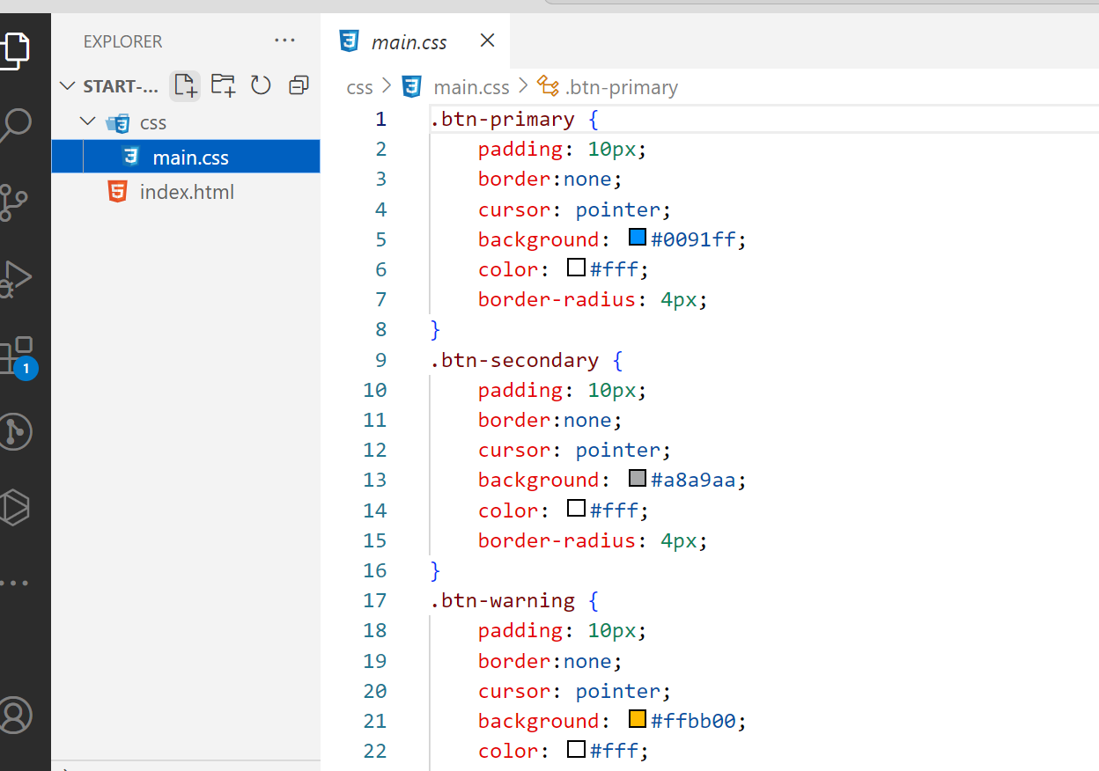
INSTRUCTION
CLEAN CODE

Slide 2
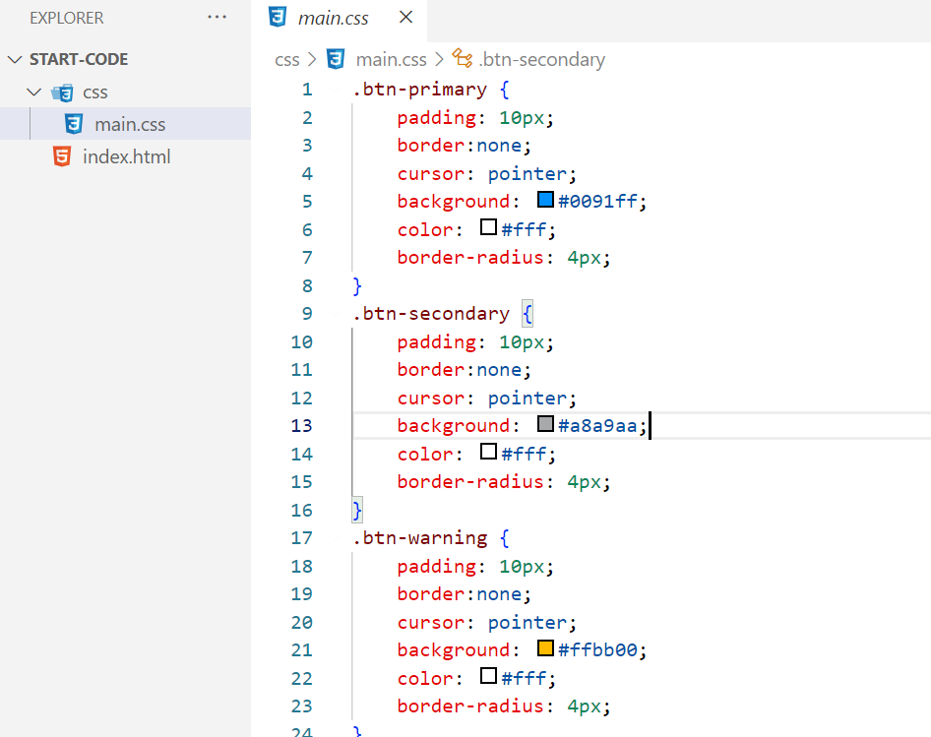


From start-code try to clean CSS code in 2 ways:
1
Using CSS
2
Using SASS

Slide 3
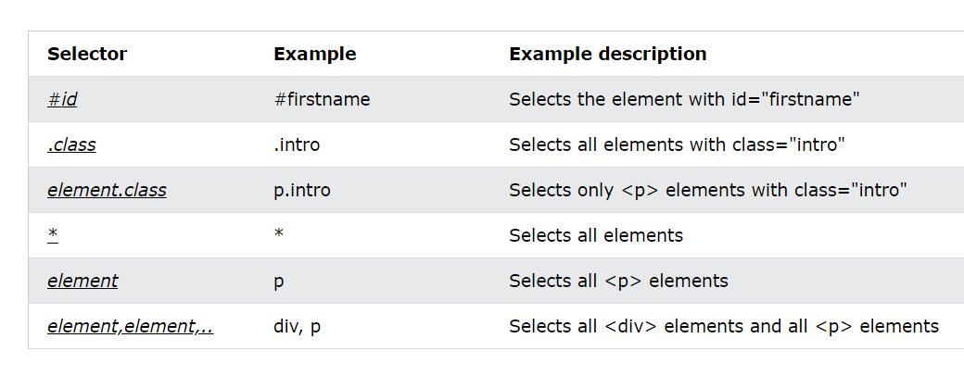
In CSS way you can use:
Grouping selector
Universal selector

Slide 4
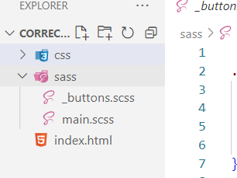
In SASS way you can use:
Import
Extend
Mixin - includes

